Slide 1
Qlik Privacy Integration
Supporting GDPR, HIPAA, PCI, PII and other privacy certifications/standards
Steve Newman, OEM Technical Manager
August 2017

Slide 2
Qlik Privacy Integration (QPI)
Goal of Project
Data Flow
Demonstration
Outstanding Activities

Slide 3
QPI Project Goals
Goal:
Provide a reference architecture to secure specific sets of data (PII) contained in a Qlik Application (both in memory and at rest) ensuring that ANY access to the data can be logged for future analysis.
Deliverables:
Example implementation using Qlik's new Advanced Analytics Integration (AAI) capability (leveraging Python).
Example Qlik Application (with data to be encrypted {Load level} and decrypted {Sheet level})
Qlik Application: Log Analysis Application that reads logged data
Best practices for:
Encryption (using tags and subroutines)
Decryption (using Master Items for ease of authoring reuse and future updates)
Aggr/Advanced function use - leverage encrypted field directly (not decrypted, for performance).

Slide 4
QPI Data Flow
Qlik Engine
AAI: Python
Encrypt()
Decrypt()
AAI: Python
Encrypt()
Decrypt()
AAI: Python
Encrypt()
Qlik App
Qlik Load Script

Slide 5
QPI Data Flow
Qlik Engine
AAI: Python
Encrypt()
Decrypt()
AAI: Python
Encrypt()
Decrypt()
AAI: Python
Encrypt()
Qlik App
Qlik Load Script
In Memory Data

Slide 6
QPI Data Flow
Qlik Engine
AAI: Python
Encrypt()
Decrypt()
AAI: Python
Encrypt()
Decrypt()
AAI: Python
Encrypt()
Decrypt()
Qlik App
Qlik Load Script
Sheets
Log Files
In Memory Data

Slide 7
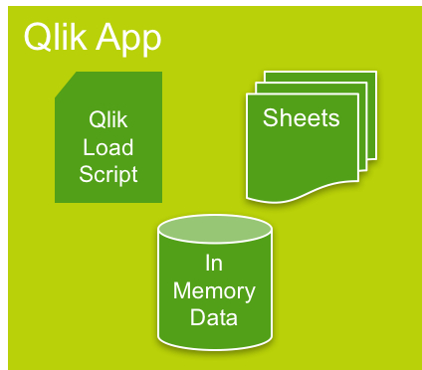
QPI Data Flow
Qlik Engine
AAI: Python
Encrypt()
Decrypt()
AAI: Python
Encrypt()
Decrypt()
AAI: Python
Encrypt()
Decrypt()
Qlik App
Qlik Load Script
Sheets
Log Files
In Memory Data
Log Analysis Qlik App

Slide 8
QPI Data Flow – getField() (alternative)
Qlik Engine
AAI: Python
Encrypt()
Decrypt()
AAI: Python
Encrypt()
Decrypt()
AAI: Python
getPIIfield()
Qlik App
Qlik Load Script
Sheets
Log Files
In Memory Data
refId
ONLY
Log Analysis Qlik App
In Sheet/Visualization/Master Item: =getField(field,refId,user_info,comment)

Slide 9
QPI Data Flow
Qlik Engine
AAI: Python
Encrypt()
Decrypt()
AAI: Python
Encrypt()
Decrypt()
AAI: Python
Encrypt()
Decrypt()
Qlik App
Qlik Load Script
Sheets
Log Files
In Memory Data
Log Analysis Qlik App

Slide 10
Demonstration

Slide 11
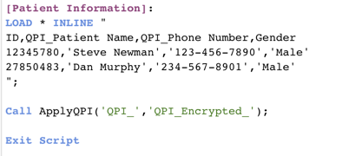
DEMO: Load Script
Leverages a Load Script Subroutine
All Columns with “QPI_”, are encrypted and then dropped from the model (for QVD and/or QVF)
No ”QPI_” data is stored unencrypted

Slide 12
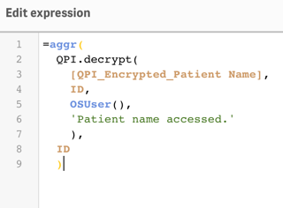
DEMO: Master Items
Leverages aggr, to make into a Dimension
Decrypts the data on the fly (as the user accesses)
Logs data into sample Log Analysis app
Field ID, User (OSUser), and Comment
Enables field search support
Selects on “ID” from aggr

Slide 13
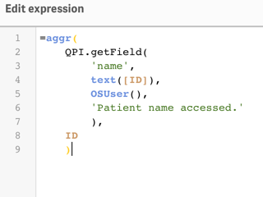
DEMO: Master Items getField() example
Leverages aggr, to make into a Dimension
Retrieves data on the fly (as the user accesses)
No data is stored in the Qlik Application/QVD files
Logs data into sample Log Analysis app
Field ID, User (OSUser), and Comment
Enables field search support
Selects on “ID” from aggr

Slide 14
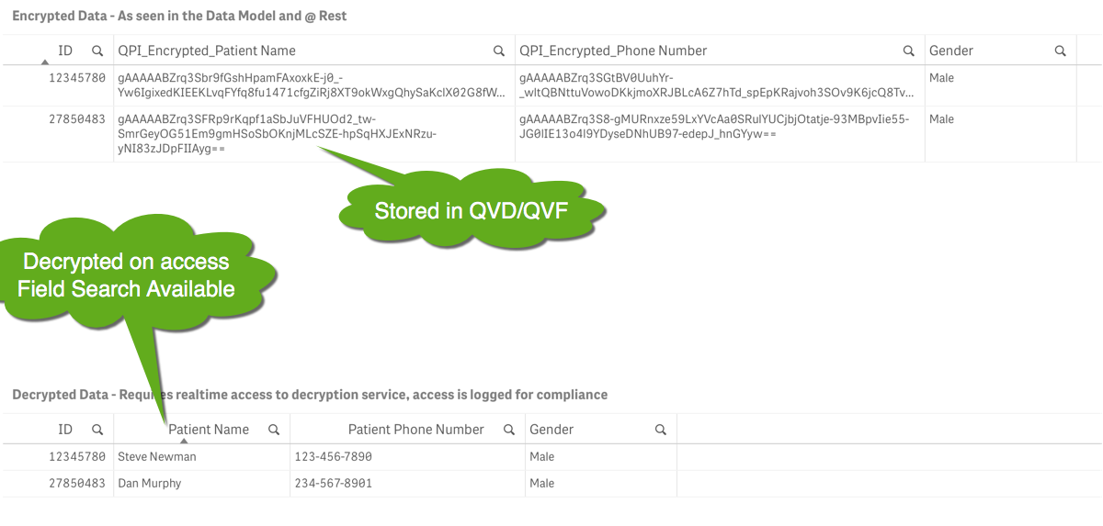
DEMO: User View

Slide 15
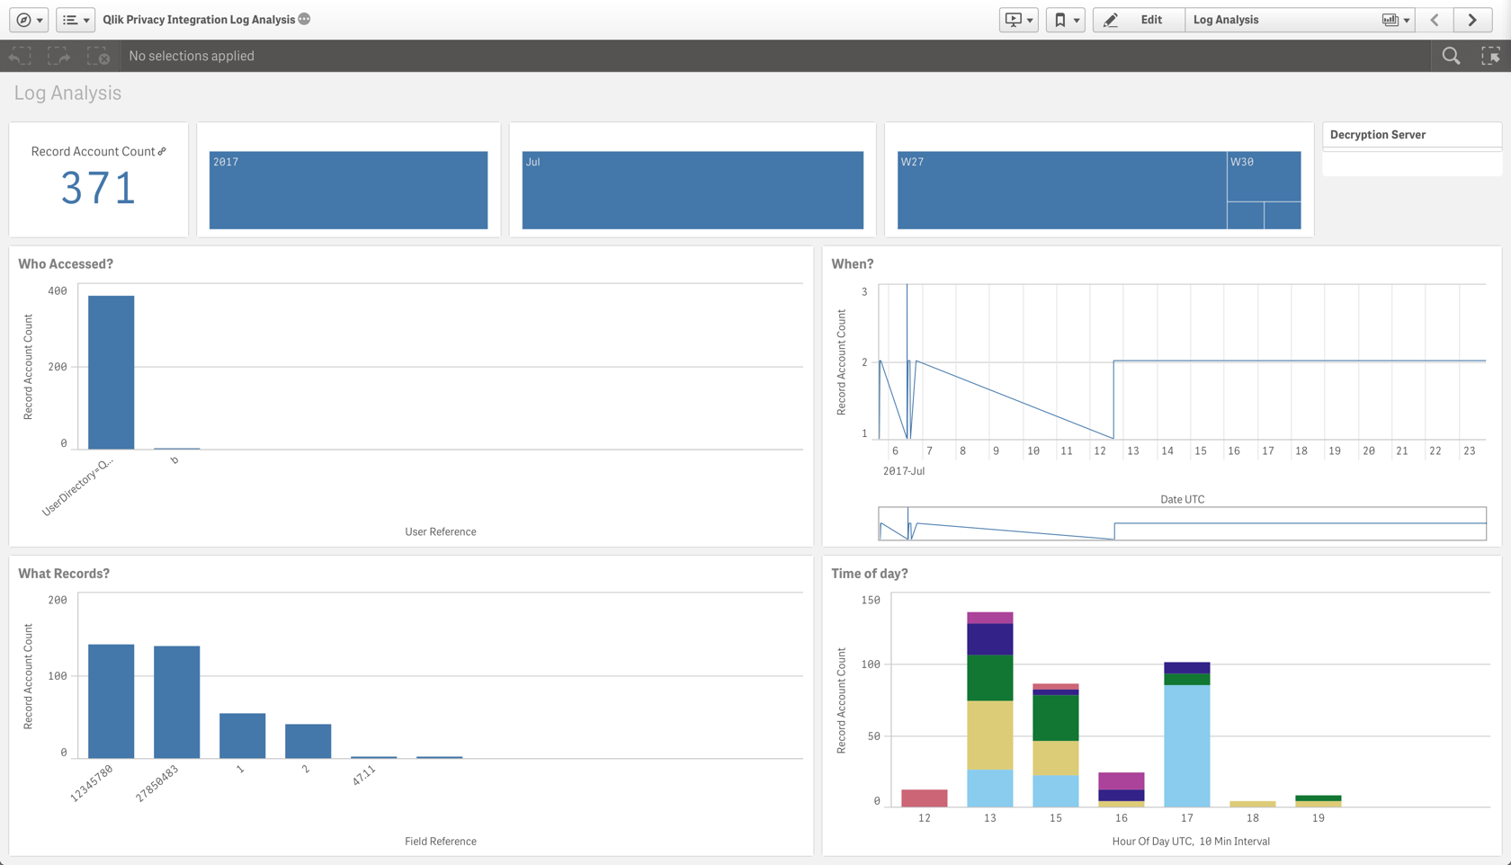
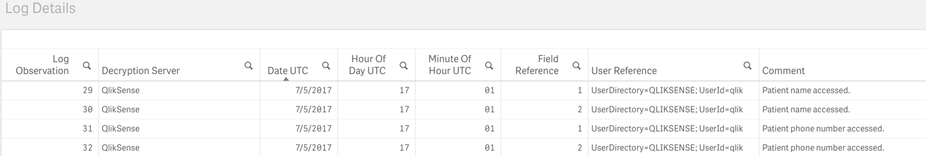
DEMO: QPI Data Access Log Analysis
Who (Qlik User) accessed what data?
When (date and time) did they access it?
From what server?
Comment Field Search
Transaction logs

Slide 16
QPI Remaining Items
Test at scale – Data Load, User Load
Currently there are known Qlik Sense Engine performance limitations with large data sets and AAI (see Enhancement Slide, next)
Improve Log Analysis App
Package and Deploy @ github
Further optimize python routines
Add support for qpi.getPIIfield(refId,field,user,comment) example function
Add support for certificates (secured communication between servers)
Repackage/deploy

Slide 17
For Qlik Product Development Enhancement Request
Enhance current Qlik Sense Engine with the following native functions:
Encrypt() and Decrypt()
Using Sense Certificates as cipher keys
Allowing configurable logging options (including log to repository DB)
Eliminates the need to use AAI
Significantly improves scalability
Significantly improves performance
Future –
Improved caching support - Performance/Scale
Decrypt and cache results once per application open, but log on every access
Direct support for “tagged” PII fields
Auto encrypt/decrpt/log to allow support for all Qlik functionality (including search, etc…)

Slide 18
Thanks!

